Slide 1
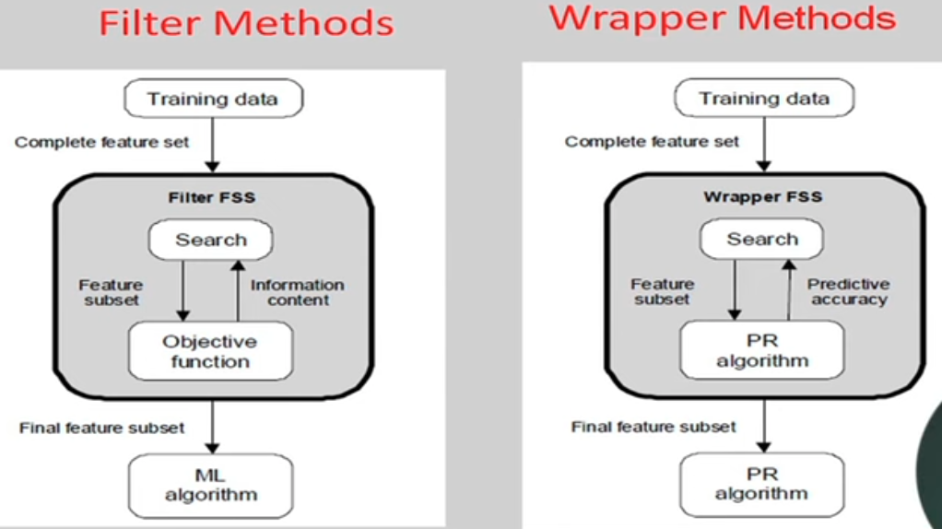
Feature Selection & Feature Extraction
Dimensionality Reduction

Slide 2
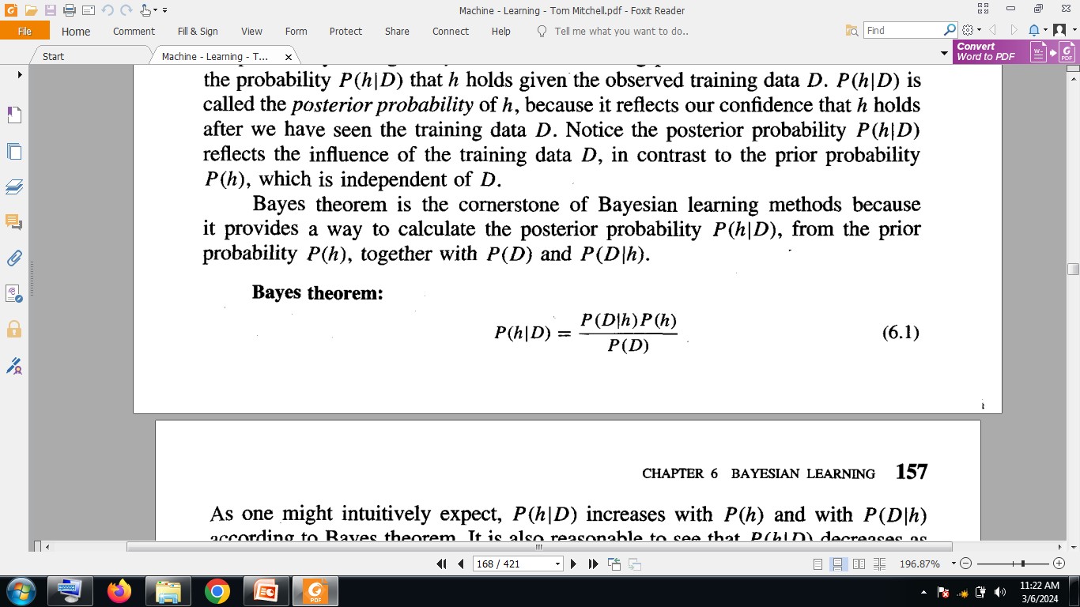
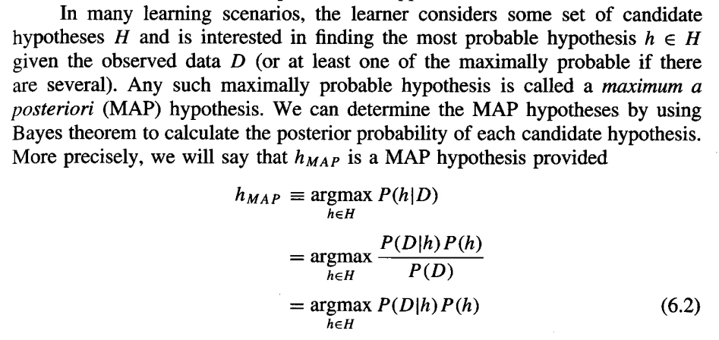
Bayesian Learning

Slide 3
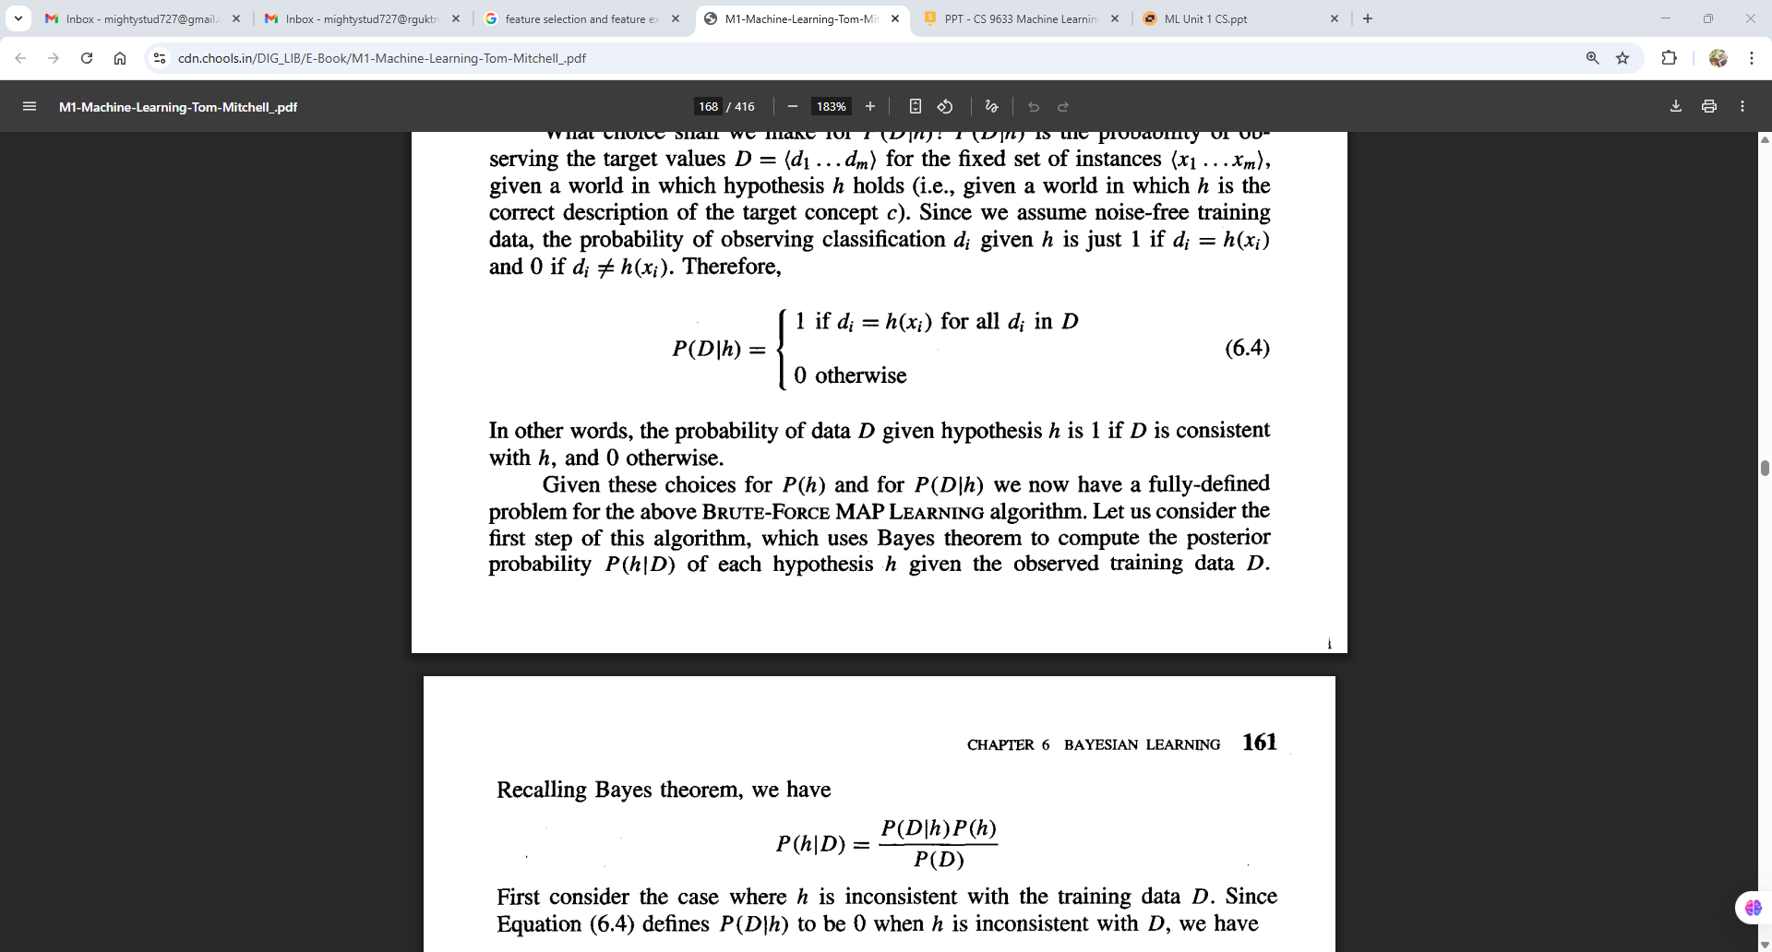
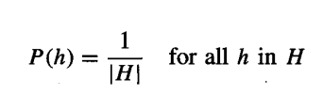
Bayesian Learning

Slide 4
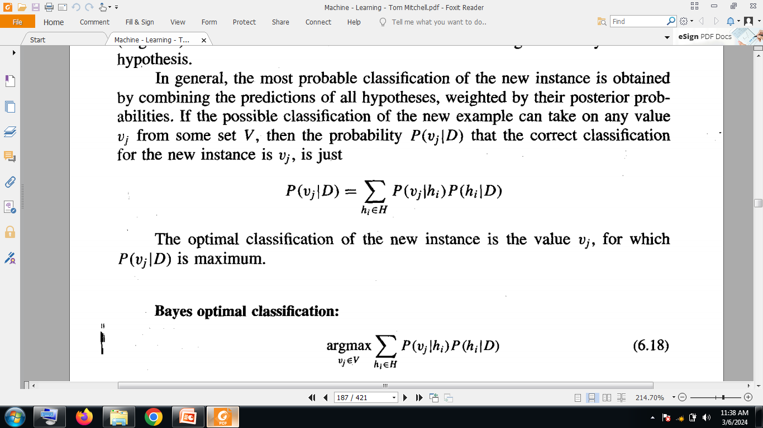
Optimal Classifier

Slide 5
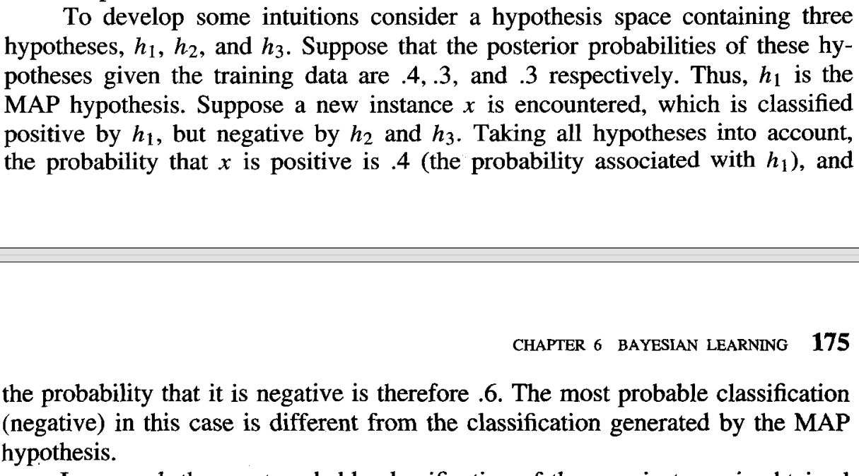

Slide 6
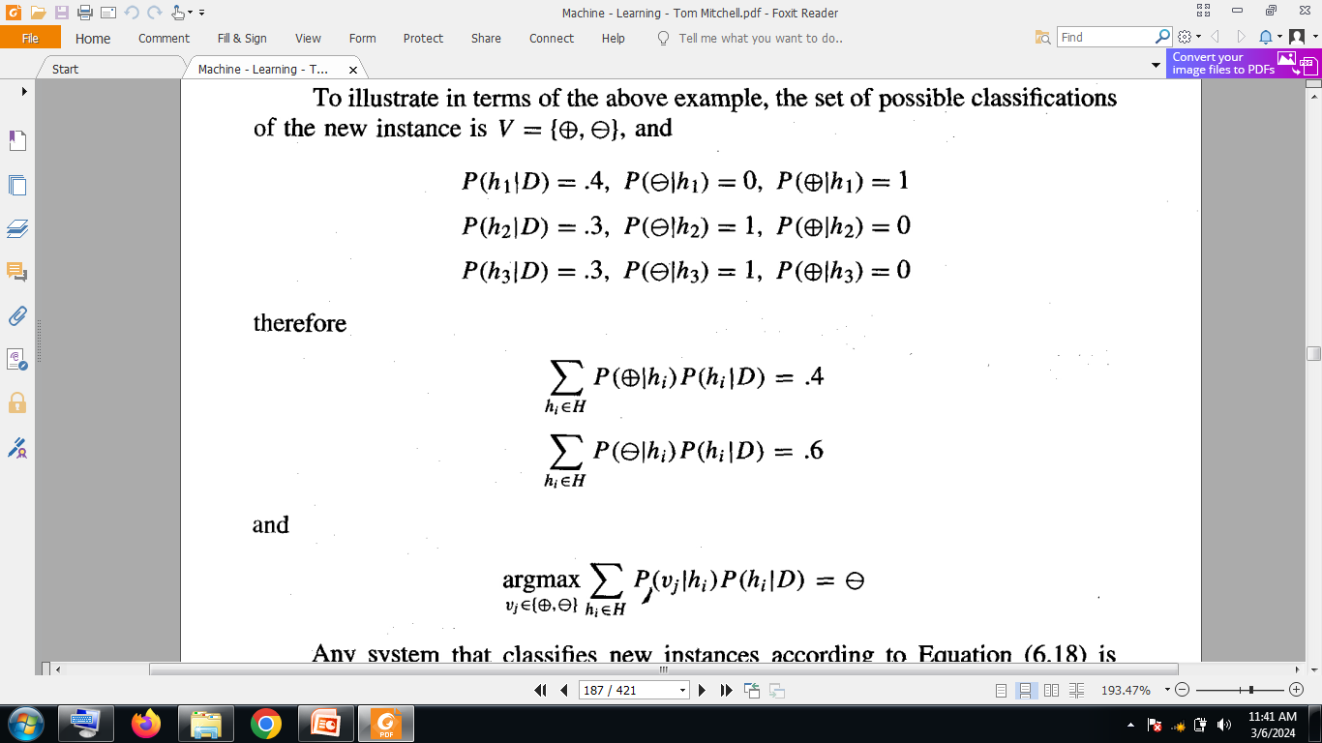

Slide 7
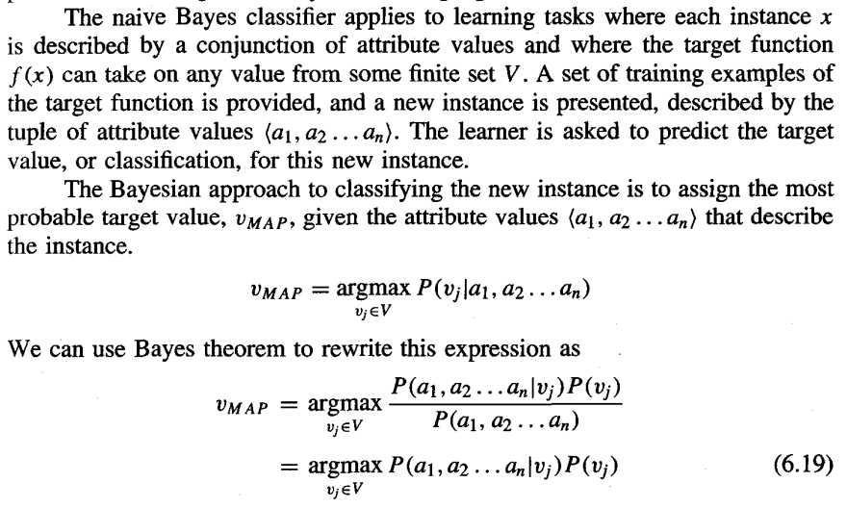
Naïve Baye’s Classifier

Slide 8
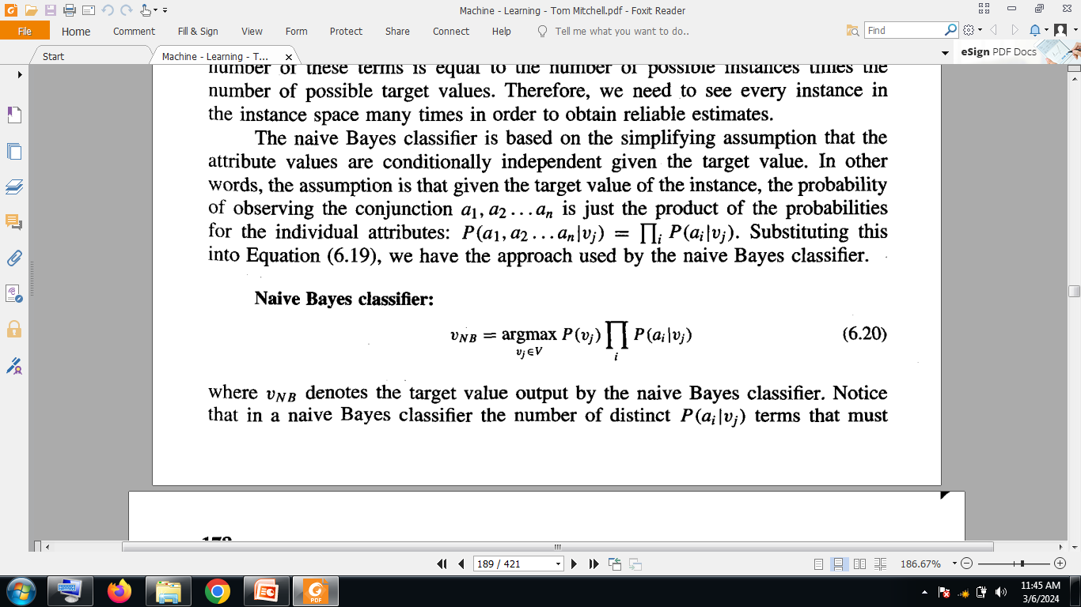

Slide 9
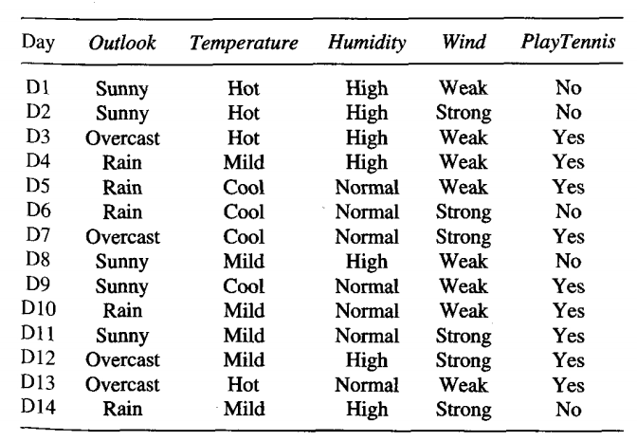
Ref: Data Set from Tom Mitchell

Slide 10
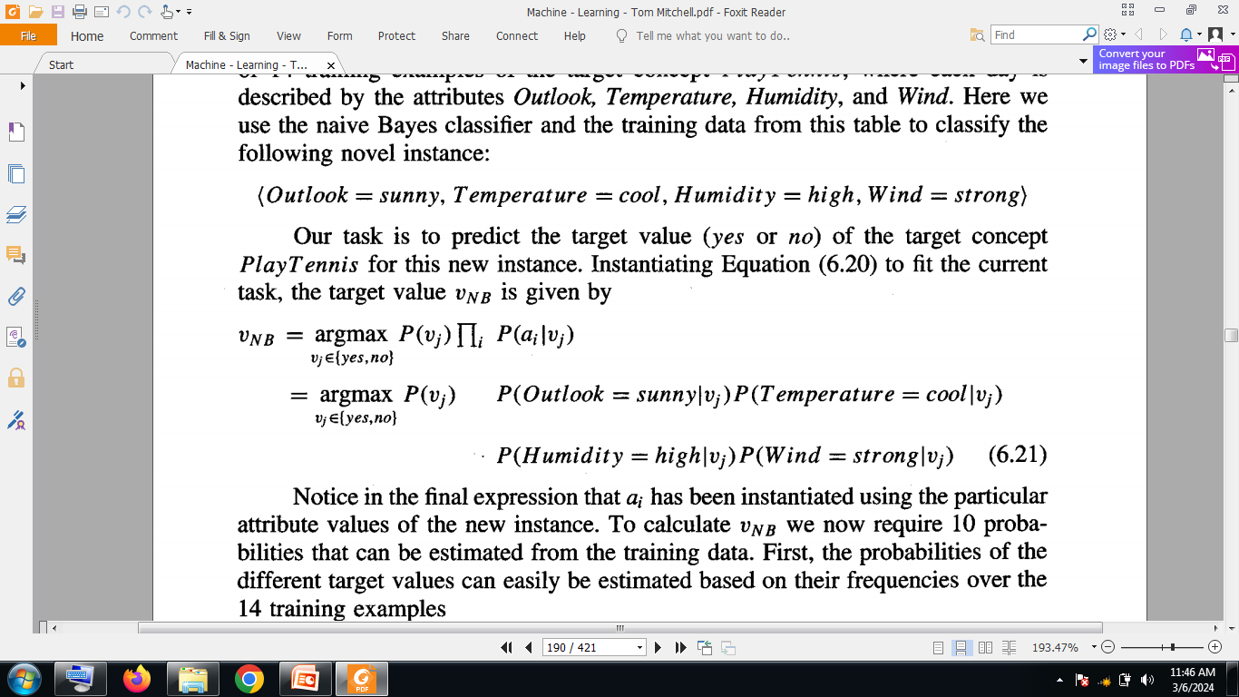

Slide 11
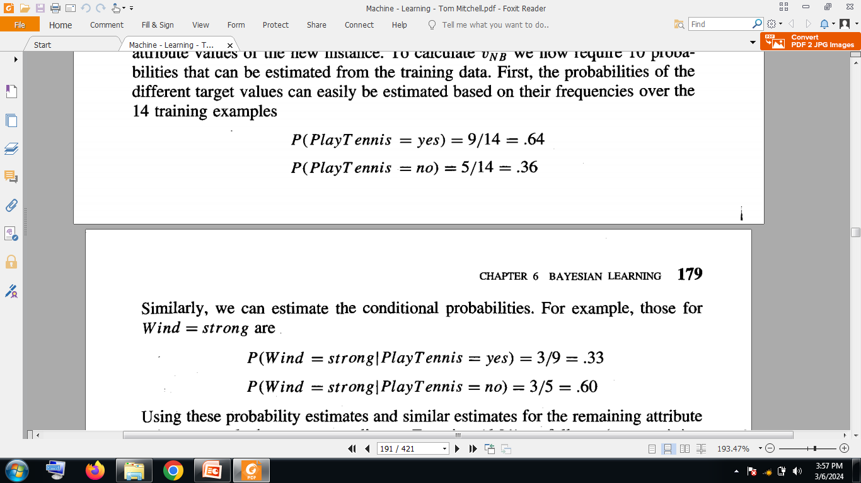
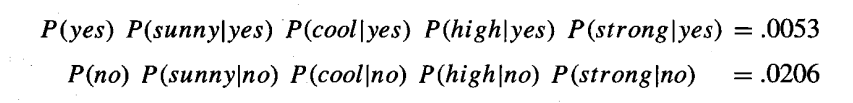

Slide 12
P(Sunny/Yes)=0.2
P(Sunny/No)=0.6
P(cool/Yes)=0.33
P(cool/No) =0.2
P(high/Yes)=0.33
P(high/No)=0.8

